Slide 1

Welcome!
MRAC Members please: Turn on cameras, remain on mute, and put your full name and the word MEMBER in your zoom box
Public participants, please: Turn off cameras, remain on mute, and put your full name in your zoom box
There will be 5 minutes of public comment at the closing of the meeting. Public comment can be made in chat at the end of the meeting as well.
Chat is open – We ask that Public Participants only use the chat during the Public Comment period at the end of the meeting
The agenda and other documents will be in the chat
There is one breakout session for MRAC members, and public participants will remain in the main zoom room for a discussion
For tech support during the meeting, message CalTrin in the chat
All current and prior meeting materials will be on the Child Welfare Council website. Link is in the chat.
Mandated Reporting Advisory Committee Members
and
Public Participants
July 17, 2025

Slide 2
Agenda
Housekeeping
Getting to Know Each Other
Setting The Stage: Implementation Framework
Breakouts: Moving to Action Plans
Full Group Discussion
Public Comment
Next Steps & Closing Remarks
MRAC Members: Name and MEMBER in zoom box, cameras on if possible
Public Participants: Name in zoom box, cameras off, and mute on
Chat is open – We ask that Public Participants only use the chat during the Public Comment period at the end of the meeting
Host will put materials in the chat

Slide 3
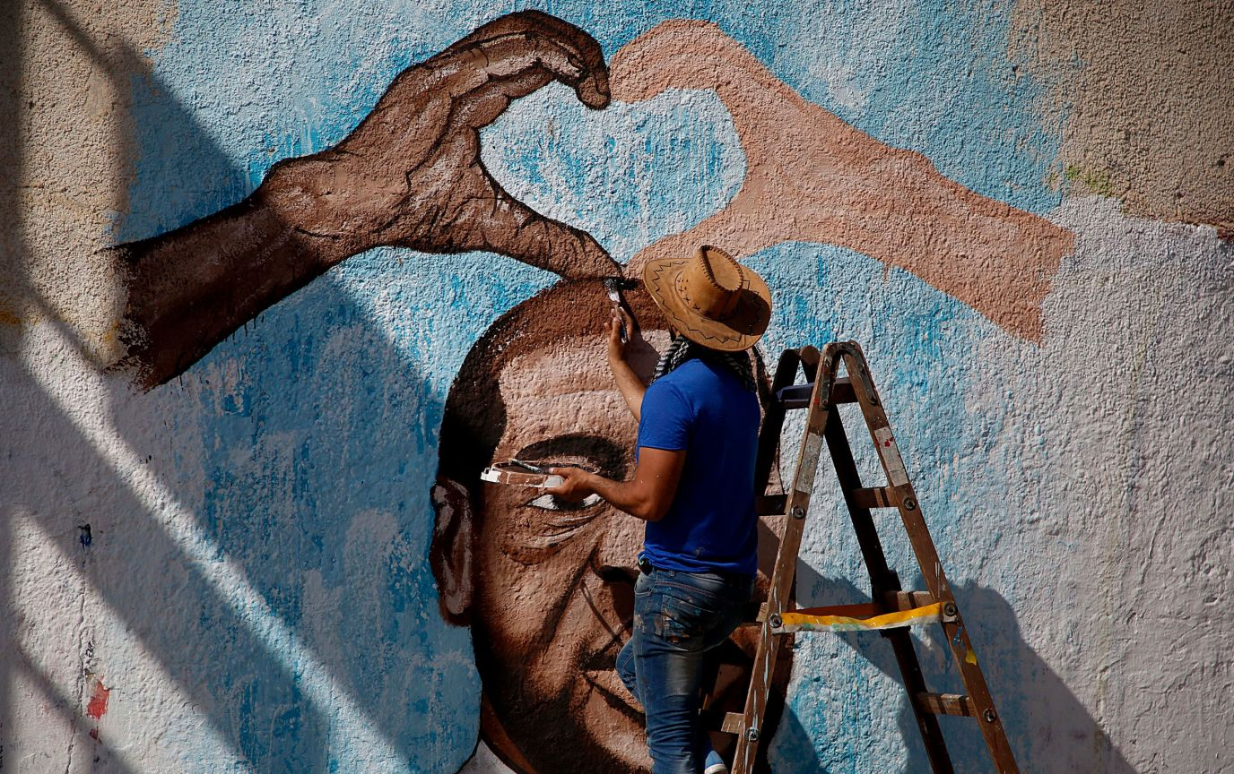
What part of this invitation is resonating with you right now?
Invitation to Create Necessary Space
Adapted from Micky Scott BeyJones Scott
Together we will bravely create “necessary” space,
Because there is no such thing as a “safe space.”
We exist in the real world,
We all carry scars, and we have all caused wounds.
We seek to turn down the volume of the outside world;
We amplify voices that fight to be heard elsewhere.
We call each other to more truth and love.
We have the right to start somewhere and continue to grow;
We have the responsibility to examine what we think we know.
We will not be perfect.
This space will not be perfect.
It will not always be what we wish it to be,
But it will be our necessary space together.
We will work on it side by side.

Slide 4

The Art of Conversation Behaviors
We acknowledge one another as equals
We stay curious about each other
We recognize that we need each other’s help to become better listeners
We slow down so we have time to think and reflect
We remember that conversation is a natural way humans think together
We expect it to be messy at times
We use “I feel”, “I believe”, or “In my experience” statements

Slide 5
Introductions & Connections

Slide 6
COMPONENTS OF A CHILD AND FAMILY WELL-BEING SYSTEM
DRAFT Updated: July 2025
Child Welfare Council (CWC)
California Department of Social Services (CDSS)
Steering Committee*
Tri-Chairs, PEI Co-Chairs, Former MRCS Task Force Co-Chairs,
CalHHS, CDSS, Staffer
FFPS Advisory Committee*
Mandated Reporting Advisory Committee (MRAC)
Tri-Chairs: LEX + CWC member + child/family serving system representative:
appointed by CalHHS, CDSS and PEI
Members: Includes diversity of role, race, & proximity to mandated reporting. Recruited from: 1) Members of former MRCS Task Force, aligned CalHHS departments, and aligned statewide associations
TBD: Workgroups on Key Levers: Data & Accountability, Mandated Reporter Training, Policy, Community Pathway Connections, Narrative Shift
Community Pathway Advisory Subcommittee*
IV-E Advisory Subcommittee
Training & TA Subcommittee*
CQI Subcommittee*
Includes (or will) individuals with lived expertise
Alignment with existing structures will be prioritized
* Includes individuals with lived expertise

Slide 7
INTRODUCTIONS
Please RAISE YOUR VIRTUAL HAND When Your Group Is Called
Please share:
Name
Organization
Home Community
MRAC Steering Committee
MRAC Members
            - Community Partners
            - CA Health & Human Services
            - Statewide Associations
            Project Management Team

Slide 8
Setting the Stage: Implementation Framework

Slide 9
Moving Into Implementation
Data/Accountability
Policy/Legislation
Training
Community Pathways: How Mandated Reporters can connect to supports and services
Narrative Shift
The Recommendations are each connected to a key lever of change to focus the implementation strategy

Slide 10
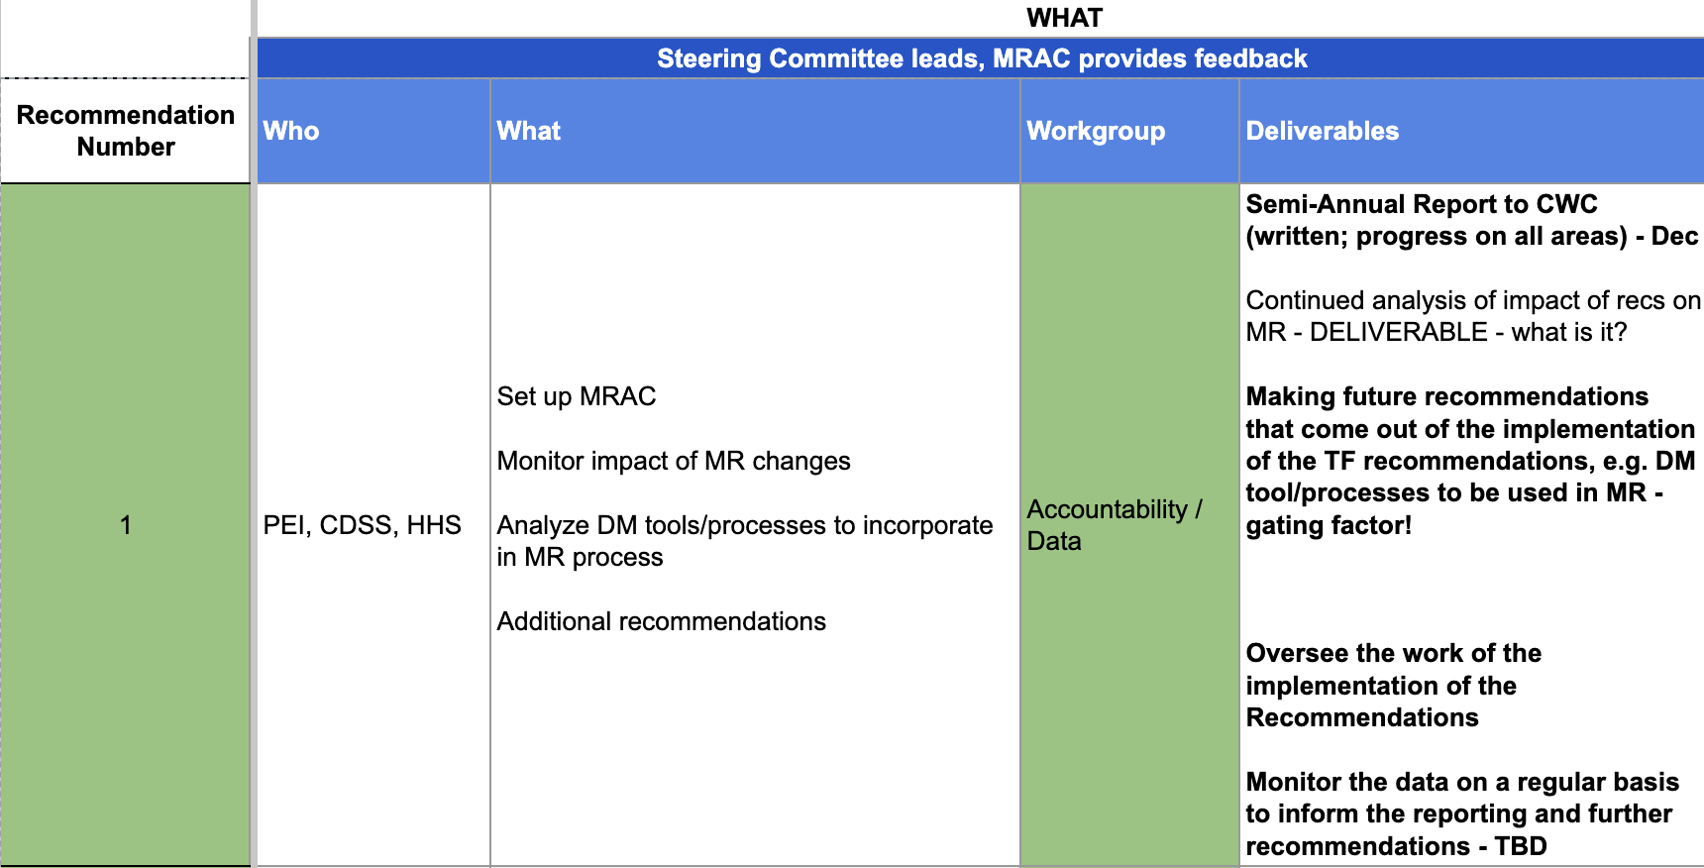
Starting with the “What” = the Recommendation
EXAMPLE
The Steering Committee “deconstructed” all 14 Recommendations to help set the stage
MRAC Action: Review the “What” for understanding, and to lift-up any clarifying questions or concerns
Reco #
Who is listed in the Reco as responsible
High level things the “Who” is supposed to do, per the Reco
Key Lever of Implementation = Workgroup
Specific deliverables as stated in the Reco – these may need more discussion for deeper understanding. Action plans will be developed to deliver these

Slide 11
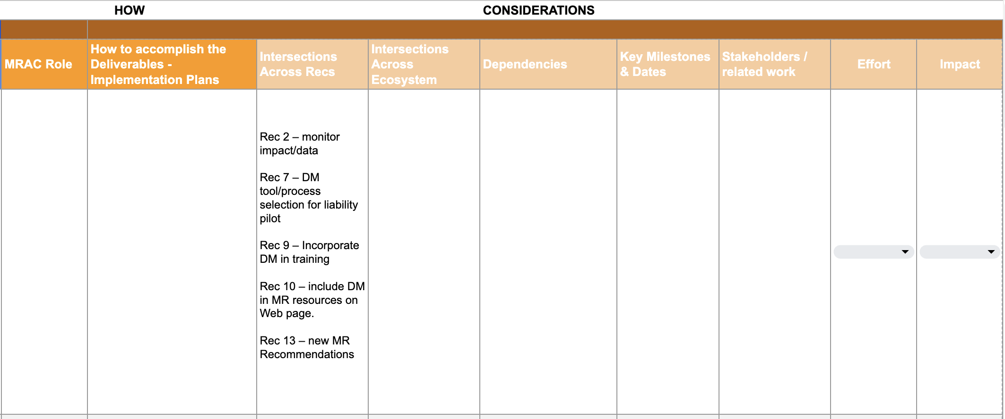
And then move into Action Plans for “How”
EXAMPLE
After the July meeting the
MRAC Action will be to begin working on the “How” – with support from the Steering Committee and Project Management Team
Considerations are things to reflect on and use to help develop action plans
We will crosswalk the Intersections across Workgroups to help identify where short-term teams may be needed to take quick action that will advance numerous Recos

Slide 12
Small Group Breakouts: Putting the Framework into Action
Introduce yourselves, and make sure you know your Steering Committee and Project Management (PM) support people
The PM will take detailed notes
However, please select a Workgroup member to jot down key points and be ready to report out
Each Workgroup Member should answer, and the group discuss:
  What does this recommendation mean in your own words
  Is it clear what the Deliverables are, as stated in each recommendation? REMINDER, you will soon begin to develop actionable implementation plans for the Deliverables
Your group has 30 minutes to do the following

Slide 13
Full Group
Share Out
Each group has ~ 4 minutes to share the following information with the full group
How well does the Workgroup understand the Recommendations that are part of your Workgroup action area?
Do you feel prepared to meet again, before the August meeting, to begin to discuss action plans?
What do you need from the Steering Committee and/or PM team to be prepared to meet again before the August meeting?
TIME PERMITTING in your breakout group: What do you want to have accomplished between now and our next whole-group meeting in August?

Slide 14

Public Comment
Raise your virtual hand
Come off mute. Turn on your camera if you like
Maximum of 2 minutes for comment which will go on public record
You can put comments in the chat that will go on the record
No response will be provided

Slide 15
Closing Comments
&
Next Steps

Slide 16
REMINDER: Expectations
MRAC
Guide and oversee the implementation of the MRCS Task Force Recommendations
There are updates on the MRAC’s work at the quarterly Child Welfare Council meetings
Members
5 - 7 hours/month
  MRAC meetings and prep
  Work between meetings
You represent your “seat,” not your organization or agency. Your organization or agency can support you, and you can reference them in your communications, but you are responsible for bringing expertise, insights, perspectives, and a broad voice from the group that you represent.
You are champions and ambassadors for the work of the MRAC, and for children and families. We will provide co-created communications materials to represent the work and invite support.

Slide 17
Next Steps
Next meeting is Thursday, August 21
Work between meetings
  Meet at least once as a Workgroup – your PM will follow-up to support setting a meeting and agenda
Check that you have accepted the following meeting invites: August 21, September 18, October 16, November 20, and December 18
Registration links will come in advance of each MRAC meeting

Slide 18
Thank you!

