Slide 1
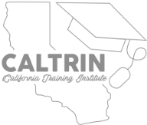
Strategies to Prevent Child Abuse and Neglect
Presented by CalTrin and the CEBC
The Centers for Disease Control and Prevention, or CDC, has done a thorough review of research on strategies and approaches that impact child abuse and neglect or the risk factors for abuse and neglect.
CDC studies have identified 5 main strategies that are supported by research evidence for the prevention of child abuse and neglect.
CalTrin is committed to helping family-serving professionals turn information into action.
For this reason, we have created a worksheet to help you identify ways you can implement the recommended strategies as an individual contributor and as an organization.
For more information and resources visit: www.caltrin.org | www.cebc4cw.org
Notes:
Reminder: We all need to work together to prevent child abuse – no one organization or agency can do it alone.
Its clear that the strategies and approaches require a community effort
Individuals or organizations can do pieces, but need to be part of a larger effort to be successful
Positive connection and collaboration – multiplier effect if working together, synergy
Importance of outcomes and evaluation
Action steps – what can I do next?
Worksheet: Revisit at the 2 week mark (remind them that they should be using)
2 month mark : check in about progress
There are a lot of great events happening this month! In addition to the CalTrin-hosted training events Dana discussed earlier, you can check out a series of virtual workshops hosted by OCAP and the Child Abuse Prevention Center. The events are FREE to attend and we’ll drop the link to learn more and register in the chat: on our website.
Wednesday, April 14: The Power of Connection by Kevin Campbell
Wednesday, April 21: Effective ways to embrace the reality of race, racism through belonging by Corey Best
Wednesday, April 28: Prevention in California Panel Discussion with Ron Brown, Katie Albright, Angela Ponivas and Sheila Boxley

Slide 2
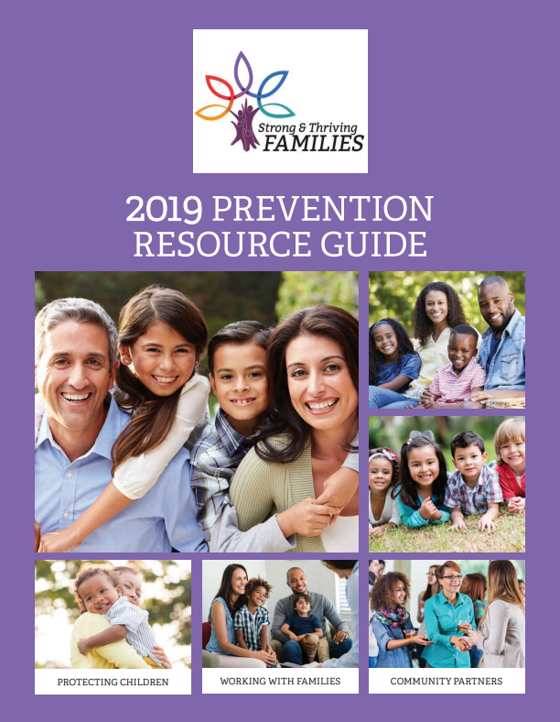
Additional Resources
Community Effort:
Multi-agency initiatives and collaboration
Shared funding streams
Legislative involvement
Social marketing and media campaigns
Synergy:
Produce a combined effect greater than the sum of their separate effects.
We can accomplish more by connecting and collaborating regularly as professionals
Child Abuse Prevention Councils (CAPC):
Attend your local Child Abuse Prevention Councils (CAPC) meetings
https://www.cdss.ca.gov/inforesources/ocap/parent-resources/capc-map
Family Support & Strengthening Network:
Get involved with or establish a Family Support & Strengthening Network for your county or region
2+ Family Resource Centers that work together to ensure coordinated quality support for families.
California Family Resource Association (CFRA)
https://californiafamilyresource.org/
California Child Wellbeing Coalition e-Guide:
County-level organizational resources
https://www.cdss.ca.gov/Portals/9/OCAP/California%20Child%20Wellbeing%20Coalition%20e-Guide.pdf
Would you like a FREE HARD COPY of the 2019 Prevention Resources Guide?
Email info@caltrin.org to request your free copy today while supplies last.
For more information and resources visit: www.caltrin.org | www.cebc4cw.org
Notes:
Reminder: We all need to work together to prevent child abuse – no one organization or agency can do it alone.
Its clear that the strategies and approaches require a community effort
Individuals or organizations can do pieces, but need to be part of a larger effort to be successful
Positive connection and collaboration – multiplier effect if working together, synergy
Importance of outcomes and evaluation
Action steps – what can I do next?
Worksheet: Revisit at the 2 week mark (remind them that they should be using)
2 month mark : check in about progress
There are a lot of great events happening this month! In addition to the CalTrin-hosted training events Dana discussed earlier, you can check out a series of virtual workshops hosted by OCAP and the Child Abuse Prevention Center. The events are FREE to attend and we’ll drop the link to learn more and register in the chat: on our website.
Wednesday, April 14: The Power of Connection by Kevin Campbell
Wednesday, April 21: Effective ways to embrace the reality of race, racism through belonging by Corey Best
Wednesday, April 28: Prevention in California Panel Discussion with Ron Brown, Katie Albright, Angela Ponivas and Sheila Boxley

