Slide 1

Welcome!
MRAC Members please: Turn on cameras, remain on mute, and put your full name and the word MEMBER in your zoom box
Public participants, please: Turn off cameras, remain on mute, and put your full name in your zoom box
There will be 5 minutes of public comment at the closing of the meeting. Public comment can be made in chat at the end of the meeting as well.
Chat is open – We ask that Public Participants only use the chat during the Public Comment period at the end of the meeting
The agenda and other documents will be in the chat
There is one breakout session for MRAC members, and public participants will be invited to a separate breakout room for discussions about the work
For tech support during the meeting, message CalTrin in the chat
All current and prior meeting materials are on the Child Welfare Council website. Link is in the chat.
Mandated Reporting Advisory Committee Members
and
Public Participants
August 21, 2025

Slide 2
Agenda
Housekeeping
Moving Into the Space Together
Expectations and Process Update
Breakouts: Creating Plans
Full Group Discussion
Public Comment
Next Steps & Closing Remarks
MRAC Members: Name and MEMBER in zoom box, cameras on if possible
Public Participants: Name in zoom box, cameras off, and mute on
Chat is open – We ask that Public Participants only use the chat during the Public Comment period at the end of the meeting
Host will put materials in the chat

Slide 3
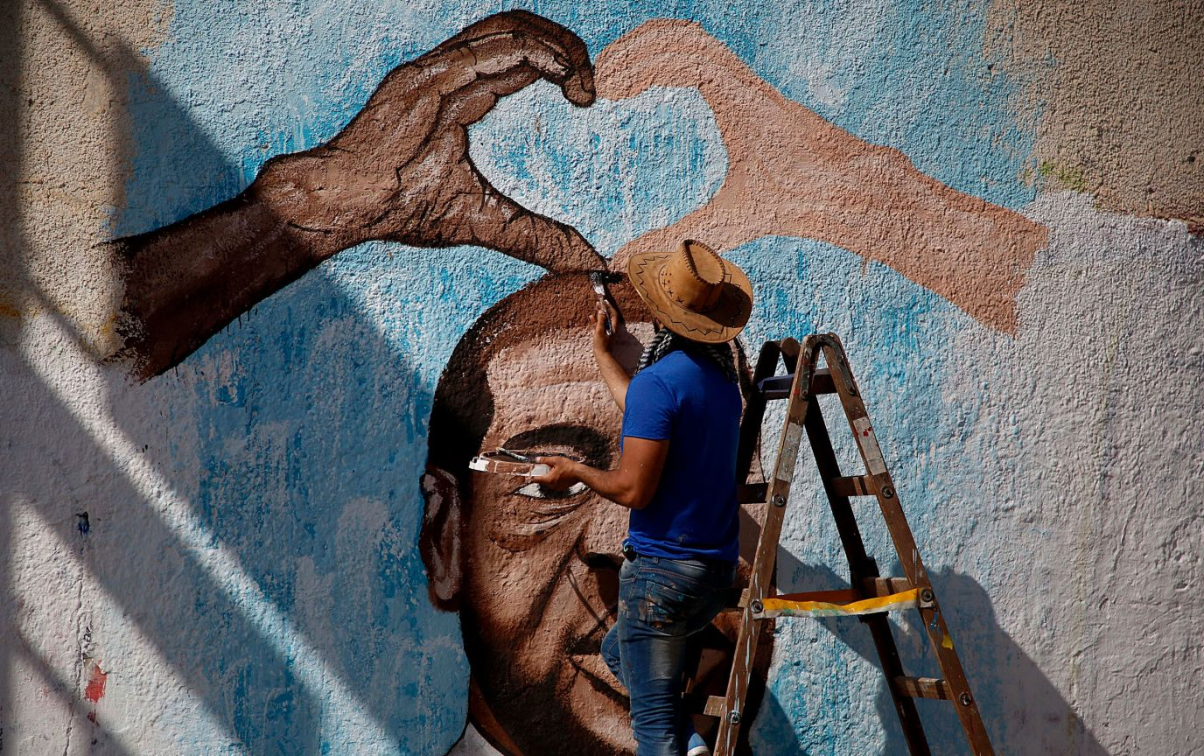
What part of this invitation is resonating with you right now?
Invitation to Create Necessary Space Adapted from Micky Scott BeyJones Scott
Together we will bravely create “necessary” space,
Because there is no such thing as a “safe space.”
We exist in the real world,
We all carry scars, and we have all caused wounds.
We seek to turn down the volume of the outside world;
We amplify voices that fight to be heard elsewhere.
We call each other to more truth and love.
We have the right to start somewhere and continue to grow;
We have the responsibility to examine what we think we know.
We will not be perfect.
This space will not be perfect.
It will not always be what we wish it to be,
But it will be our necessary space together.
We will work on it side by side.

Slide 4

The Art of Conversation Behaviors
We acknowledge one another as equals
We stay curious about each other
We recognize that we need each other’s help to become better listeners
We slow down so we have time to think and reflect
We remember that conversation is a natural way humans think together
We expect it to be messy at times
We use “I feel”, “I believe”, or “In my experience” statements

Slide 5
Expectations and Process Updates

Slide 6
2025 Timeline
NOVEMBER 6th High-Level Plans Due to MRAC
Launch MRAC Workgroups
Implementation Plan Development
Jul 2025
Aug 2025
Sep 2025
Oct 2025
Nov 2025
Dec 2025
SEPTEMBER 10th
Quarterly Update
to CWC
DECEMBER 3rd
Bi-Annual Report
to CWC
MRAC Monthly Meetings – Including Workgroup Breakout Meetings
Workgroup Meetings Between MRAC Meetings

Slide 7
Setting a Cadence for the Work Ahead
Workgroups meet at least 2x/month—at MRAC meetings and longer working sessions between
High-level implementation plans by November 6th
MRAC review of plans at the November 20th meeting
Building towards December bi-annual report to the Child Welfare Council

Slide 8
Process Updates
Changes to the Implementation Framework
Working in the Framework Spreadsheet
Implementation plan template
Demo the spreadsheet

Slide 9
Ecosystem Intersections: FFPS Advisory Structure

Slide 10
Workgroup Breakouts: Revised Framework & Ongoing Planning
Welcome and introduce any new members
Select a Workgroup member to jot down key points and be ready to report out
Review the “Workgroup Roles” (column G), and discuss any changes or questions
Discuss the Chair role and seek interest
Continue to work on implementation plans, and document/raise any questions
Each Workgroup should be prepared to answer:
Feedback or questions on Workgroup Roles (column G)
Questions/hurdles to develop high-level implementation plans by NOVEMBER 6
What do you need from the Steering Committee to meet the November goal
The Project Manager will take detailed notes
Your group has 35 minutes to do the following

Slide 11
Full Group Share Out Each group has 6 minutes to share the following information with the full group
Feedback and questions on Workgroup Roles (column G)
Questions/hurdles to develop high-level implementation plans by NOVEMBER 6
What do you need from the Steering Committee to meet the November goal

Slide 12

Public Comment
Raise your virtual hand
Come off mute. Turn on your camera if you like
Maximum of 2 minutes for comment which will go on public record
You can put comments in the chat that will go on the record
No response will be provided

Slide 13
Closing Comments & Next Steps

Slide 14
Thank You MRAC Members
MRAC
Guide and oversee the implementation of the MRCS Task Force Recommendations
There are updates on the MRAC’s work at the quarterly Child Welfare Council meetings
Members
5 - 7 hours/month
MRAC meetings and prep
Work between meetings
You represent your “seat,” not your organization or agency. Your organization or agency can support you, and you can reference them in your communications, but you are responsible for bringing expertise, insights, perspectives, and a broad voice from the group that you represent.
You are champions and ambassadors for the work of the MRAC, and for children and families. We will provide co-created communications materials to represent the work and invite support.

Slide 15
Next Steps
Next MRAC meeting is Thursday, September 18th
Work between meetings
Meet at least once as a Workgroup – your PM will follow-up to support setting a meeting and agenda
Check that you have accepted the following meeting invites: September 18, October 16, November 20, and December 18
Registration links will come in advance of each MRAC meeting—or you can register NOW by using the links on the MRAC section of the CWC website (see the chat)

Slide 16
Thank you!

